Slide 1
La RAC pour entreprises

Slide 2
Lancement officiel du programme
ABD

Slide 3
RAC
Gestion et
Développement d’Entreprise

Slide 4
Un programme pour les gens d’affaires occupés
Flexibilité : Perfectionnez-vous quand et où vous voulez !
Des outils en ligne accessibles en tout temps.
4 options d’évaluation selon votre expertise.
Pas de délais préétablis.
Des séminaires pertinents et participatifs.
Des spécialistes disponibles et accessibles.

Slide 5
9 Compétences
Stratégies
Communication Marketing
Ventes
Médias Sociaux
Comptabilité
Droit des Affaires
Ressources humaines
Gestion opérationnelle
Gestion de la croissance

Slide 6
Les Compétences
À partir d’une idée, développer un modèle d'entreprise et une stratégie d’affaires.
Identifier la demande du marché et créer des stratégies de communication marketing intégrées efficientes pour établir une marque.
Développer une stratégie de vente pour vendre un produit/service.
Promouvoir les activités de l'organisation à travers l'utilisation des médias sociaux et des technologies de réseautage.

Slide 7
Les Compétences
Identifier des solutions à des problématiques juridiques courantes rencontrées par une entreprise.
Prendre des décisions d'affaires en utilisant la comptabilité et les concepts financiers de base.
Élaborer et gérer un plan de ressources humaines.
Mettre en œuvre des systèmes et des processus qui contribuent à l'efficacité opérationnelle et au succès de toutes entreprises.
Être en mesure d’amener son entreprise à un niveau supérieur de croissance

Slide 8
Options d’évaluation
1) Équivalence de formation
2) Portfolio et entrevue
3) Étude de cas et présentation
4) Présentation d’un travail sur sa propre entreprise ou son projet d’entreprise.

Slide 9
Partenariat avec la
CEDEC

Slide 10


CEDEC Small Business Support Network
Mission
We support communities across Quebec by providing personalized business development services in English. And we follow through with every client to make sure they have the tools to succeed.
Vision
Our goal is to support job creation, and the economic prosperity of communities throughout Quebec. We will do this by becoming the leading English-language agency championing and supporting business success.

Slide 11
BACKGROUND
2007 – CEDEC launches Small Business Support Network in Ormstown, Quebec
2008 – Conference Board of Canada reports that supporting the creation of SMEs in cultural or linguistic minority communities represents an important vehicle for job creation, as well as a powerful catalyst for economic diversification
2010 – With support from Industry Canada, CEDEC conducts study to identify the factors that stimulate or impede business growth within Quebec’s minority language English-speaking communities
Main factor identified – Quebec’s English-speaking small-business owners need a supportive environment in order to thrive

Slide 12

OUR MEMBERS
Member Benefits
Expanded connections
Increased visibility
Event discounts
Greater access to business development resources in English
Enhanced business support
Our members are SMEs from across the province of Quebec, covering virtually every sector—with service based, knowledge based, manufacturing, and consumer goods industries all well represented.

Slide 13

OUR PARTNERS
We currently collaborate with
Community organisations
Local action groups and committees
Educational institutions
Public institutions
Local trade associations
Chambers of commerce
Government agencies and offices
Private enterprises and corporations

Slide 14

Why work with Champlain College Saint-Lambert
There is a joint desire to improve access to professional development opportunities to English speaking small businesses allowing them to gain access to services in the community without having to leave their community
Joint projects:
Survey of small business owners needs
CEDEC SBSN meetings held on campus
Revision of the Applied Business Development program
Research into the development of an online resource

Slide 15


For more information:
www.cedec.ca/sbsn
sbsn@cedec.ca

Slide 16
Nos
Spécialistes

Slide 17
Charles Baribeault, BAA
Plus de 17 ans d’expérience en ressources humaines dans des corporations nationales
BAA HEC Montréal
Gradué de Champlain en 1987

Slide 18
Bart Kasowski, MBA
Contribué au développement ABD RAC
BA, Harvard University
MBA, HEC Montréal
Ph. D, Université de Paris IV-La Sorbonne
Ph.D, Université de Montréal
Plus de 12 ans d’expérience en Marketing International

Slide 19


Isabelle Stébenne, BAA, MBA
Plus de 18 ans d’expérience en communication marketing
MBA, HEC Montréal
Chargée de cours en 2010-11 au programme MBA, HEC Montréal
Présidente, fondatrice de Bonza inc.
Spécialiste de contenu marketing

Slide 20
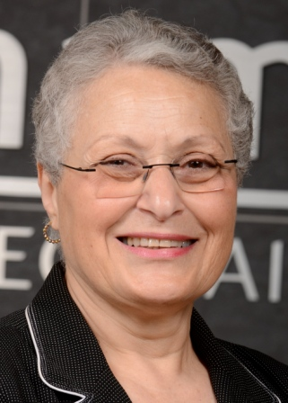
Suzanne Wassef
35 and d’experience en Finance
CFA
BAA, McGill University
Depuis 2000, Suzanne enseigne la comptabilité

Slide 21

M-J Plebon
Diplôme en génie chimique, l'Université Ryerson
25 ans d'expérience, gestion, marketing stratégique, ventes,gestion de projet, développement de produits et commercialisation
Fondateur de Communication IMPACT, il aide les entreprises à tirer parti des nombreux canaux de marketing en ligne pour obtenir une bonne visibilité.

Slide 22
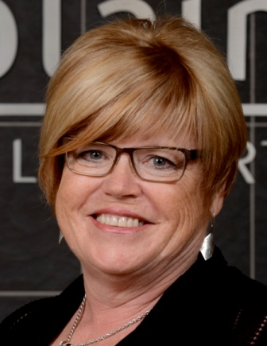
Lynda Fraser
Spécialiste de contenu pour la gestion des ressources humaines
Maîtrise en éducation
Plus de 20 ans d’expérience en enseignement et en coaching professionnel
Enseigne les Ressources Humaines à McGill University.

Slide 23

Michael Loughman
MBA, Concordia, Transport
CITT
Enseigne au Collège Champlain; Transport & Logistique, Le fondement des affaires
Coordonnateur des stages à Champlain

Slide 24
Gérard Bourdages
17 ans d’expérience en tant que consultant, analyste et enseignant
Enseignement à l’Université
Spécialiste de contenu Ventes

Slide 25



Pino Di Ioia
Un entrepreneur reconnu approuve le RAC !
MBA, McGill University
Fondateur de Queues de Castor et Moozoo (117 magasins)

Slide 26
Mentorat pour immigrants

Slide 27
Le mentorat pour immigrants
Nouveau programme
Soutien à l’intégration des personnes immigrantes
Objectif: intégration et rétention du personnel

Slide 28

Agents de partenariat

Slide 29
Agents de partenariat
Raymond Patry
Richard Vachon

Slide 30

Transport et logistique en entreprise

Slide 31
T&L for businesses
Does your company:
• Have large inventory fluctuations?
• Have late shipments and border clearance
problems?
• Pay too much for duty?
• Have optimal procurement methods?

Slide 32
T&L for businesses
RAC benefits for businesses:
• Targets training to areas of missing knowledge or skills
• Personalized and on-site training possibilities
• Increased employee motivation and productivity
• Access to current industry best practices

Slide 33
Competencies
The program addresses major issues in transportation and logistics including:
• Operating costs of logistic services
• Sales and customer service
• Purchasing management
• Operations management

Slide 34
Competencies
• Inventory control
• North American and international transportation
• Dangerous goods and environmental issues
• Supply chain management
• International agreements and harmonized Commodity Description and
Coding System
• Customs procedures
• Warehousing management

Slide 35
Partenariat
This program is a unique partnership between the “Pôle d’excellence Québécois en transport terrestre’’, the “Ministère du Développement
économique, de l’Innovation et de l’Exportation (MDEIE)’’ and Champlain College.
Over the next two years, it will provide an opportunity for 60 individuals in the Montérégie to benefit from this training program.

Slide 36
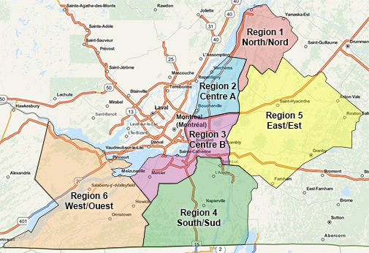
Partenariat

Slide 37
Partenariat avec le PÔLE

Slide 38
Répartition en entreprises

Slide 39

Are you experiencing:
Challenge maximizing the use of space in your trailers?
Inadequate resources to communicate with your drivers?
High mileage with empty loads?
Difficulty ensuring fuel optimization?
Late shipments and customs clearance problems at the border?

Slide 40
Competencies
Dangerous goods and environmental issues
Supervision
Transportation Laws and Regulations
Sales and Customer Service
Specialized transportation of goods
Operations management in road transport
Technologies road transport and technologies
North American transportation
Problem resolution in dispatching
Routing
Customs Procedures
Teamwork

Slide 41
Competencies
• Inventory control
• North American and international transportation
• Dangerous goods and environmental issues
• Supply chain management
• International agreements and harmonized Commodity Description and
Coding System
• Customs procedures
• Warehousing management

Slide 42
The Transportation and Logistics Dispatch Specialist program is the result of a unique partnership between Camo-Route and Champlain College.
In the coming months, this partnership will provide an opportunity for 10 participants to benefit from the training program.

Slide 43
The regular duration of the program is 455 hours:
  Content specialists cover one to two competencies per week.
  The program is distinguished by the fact that:
    An internship is incorporated into the training, comprising four days of classes and a training day
    The candidate is assigned to an experienced dispatcher/mentor in his company who will accompany him/her throughout his/her training. Feedback is provided every week to establish the link between practice and theory.

Slide 44
The funding from Camo-Route:
- Students will be compensated their salary (up to $20 per hour) during the RAC evaluation period; this includes benefits.
- Travel expenses from place of business to Champlain College for the purpose of attending the course(s) are reimbursed at the rate of $0.43 per km.
- Meal expenses for lunch during the day of the course(s) will be reimbursed upon submission of an invoice up to $14.30.

Slide 45
Partenariat avec
CAMO-ROUTE

Slide 46
Présentation de Camo-Route

Slide 47
Présentation de
ITSS

Slide 48

Information Technology Support Specialist Services for Businesses

Slide 49
WHY RAC-ITSS for Businesses?
Many employees have technical experience, but lack the formal recognition of their background

Slide 50

Employees Receive Official Recognition For Their Competency
Employees must attain competency in 19 areas of IT
Series of seminars, activities and evaluations
Boot Camp!

Slide 51
What Will RAC-ITSS Provide?
Formal college recognition of competencies
An investment in employees
Enhanced retention of employees

Slide 52
What Are The ITSS Services?
Help Desk Environment
Software
Hardware
Networking
Servers,OS’s
Communication Principles
Customer Service
Teamwork
Talk and Type
Language training
Technical Support

Slide 53
Future Services?
Cisco
Network Fundamentals
Routing Protocols & Concepts
LAN Switching and Wireless
Accessing the WAN
Social Media
Marketing / PR and Analytics
Facebook/Twitter
Podcasts/Videos
Live streaming
Search Engine Optimization

Slide 54
Who Delivers These Competencies?
Sandra Leggett
Madeleine Jean
Stephanie Gingras
Jane Nicholson
Marc-André Léger
Denis Perreault
Yves Delair

Slide 55
Take Home Message
….employers recognize that money spent on training employees is more realistically an investment rather than a cost. A more skilled workforce results in increased economic productivity.”
Source: Creating Quality Newsletter, Volume 11, Number 12, December 2002

Slide 56
À VENIR
- Cisco
- Médias sociaux

Slide 57
See you at the
Reception!...

